Slide 1
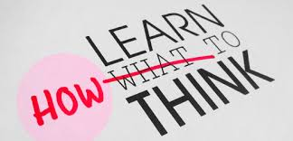
Learn to Think

Slide 2
Learning Objectives
To enable the students to understand what thinking is.
To enable them to write reflection of every class they attend of personal development course.
To enable them to develop the habit of learning new things through criticial thinking.
To educate them as to why it is important for them to think regularly and how they could become a leader without having any position if they critically evaluate every situation for better solutions.

Slide 3



Slide 4
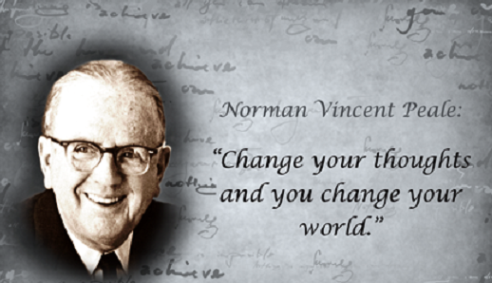

Slide 5


Slide 6
What is Thinking?
Thinking cover all of the mental activities associated with concept- formation, problem solving, intellectual functioning,
creativity, complex learning, memory and imagery .

Slide 7
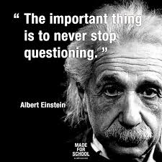

Slide 8
Why Concern
Ourselves with
Thinking?

Slide 9
Because whenever we are dealing with human life, we are almost always dealing with thinking.

Slide 10
Thinking is the way that the mind makes sense of the world.

Slide 11
There is no way to understand anything except through thinking.

Slide 12
Thinking tells us
what is there
what is happening
what our problems are
what our options are
what threatens us
what is important
what is unimportant
who our friends are
who our enemies are
what our history is
who we are
who loves us, etc., etc.

Slide 13
Thinking determines
what we learn
how we learn
what we think is important to learn
what effort we should expend
what we think is true
what we think is false
how things should be viewed
whether our learning is of high or low quality
whether our learning is deep or superficial

Slide 14
Everything we know, believe, want, fear and hope for, are determined by our thinking.

Slide 15
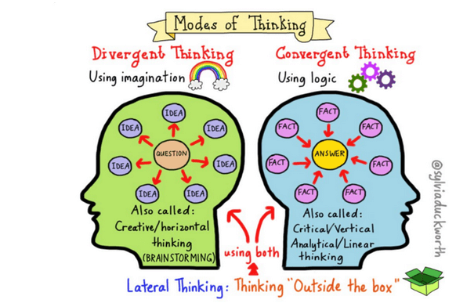

Slide 16
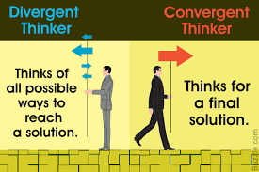

Slide 17
?
He is a bad journalist because he is a bad man.
Young people are more immoral in their behavior than older people.
Ahmar is bound to be intelligent because he is always reading.
The Pakistanis are the best people in the world.
Having just arrived in Ohio, I saw a white squirrel. All Ohio Squirrels are white.
No one can deny the justice of our cause.
He mixes with criminals, therefore he is a criminal himself.

Slide 18
Characteristics of Clear Thinking
Determinism
Determinism refers to people's behavior being determined for them by some external force.
Empirical evidence
Empirical evidence is evidence from observations. It can be through naturalistic observation
Objectivity
Judgment based on observable phenomena and uninfluenced by emotions or personal discrimination.

Slide 19
Some Fallacies in Common Thinking
A fallacy is a technical flaw which makes an argument unsound or invalid.
Arguments which contain fallacies are described as fallacious. They often appear valid and convincing; sometimes only close inspection reveals the logical flaw.

Slide 20
Vicious Circle
If you're in a vicious circle you're in a situation in which the solution to one problem becomes the cause of another one, and the solution to that one causes the first problem to occur again.
Example:
If I quit cigarettes I put on weight, and if I put on weight I get depressed, and if I get depressed I start smoking again. It's a vicious circle.

Slide 21
Common Belief
This fallacy is committed when we assert a statement to be true on the evidence that many other people supposedly believe it. Being widely believed is not proof or evidence of the truth.
Example: At one time, most people in Europe believed that the earth was the center of the solar system (at least most of those who had beliefs about such things). However, this belief turned out to be false.
God must exist. After all, I just saw a poll that says 85% of all Americans believe in God.

Slide 22
Dubious Authority
Appeal to an expert who is not expert in the area of concern.
Inappropriate Authority:
According to my dad …
Einstein said … [something about evolution]
Unidentified Authority:
Studies show …
Experts agree …
Science says …
Appeal to the Masses:
Everybody knows …

Slide 23
Attacking a Straw Man
A straw man is a common form of argument and is an informal fallacy based on giving the impression of refuting an opponent's argument, while actually refuting an argument that was not presented by that opponent.
One who engages in this fallacy is said to be "attacking a straw man”.
Example: Those who favor gun-control legislation just want to take all guns away from responsible citizens and put them into the hands of the criminals.

Slide 24
Pity and Other Emotional Appeals
Example: I am a single parent, solely responsible for the financial support of my children.
If you give me this traffic ticket, I will lose my license and be unable to drive to work.

Slide 25
Pseudo Questions
Questions that lead to nowhere.
Example: How is the mind related to the body?

Slide 26
Prejudiced Arguments(biased)
Example: Jim Bakker was an insincere Christian; therefore, all Christians are insincere.

Slide 27
False Dilemma
Often called the either/or fallacy because the argument nearly always includes the words "either... or...".
This fallacy assumes that we must choose between two opposite extremes instead of allowing for other possibilities, especially for the possibility of choosing an alternative between the extremes.
Example: Women need to be either brilliant or beautiful to survive in this world.

Slide 28
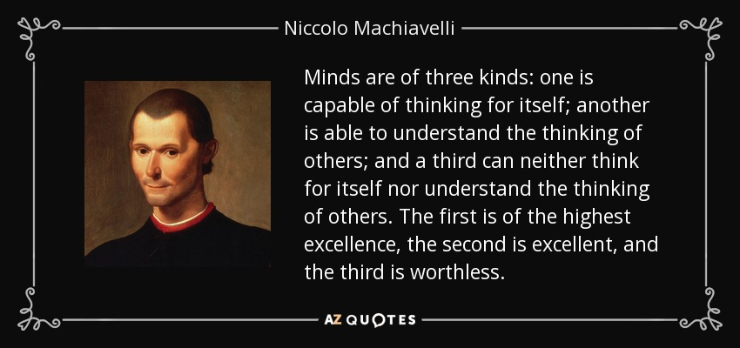

Slide 29
5 Steps to Thinking Clearly
Check Your Attitude
Have a Clear Purpose
Use Your Passion to control your Emotions
Use your Negative Thinking to produce Positive Action
Use Cool Logic in Hot Situations to reach your Goal

Slide 30
Critical Thinking
is a Self-Directed Process
by which we take Deliberate Steps
to think at the Highest Level of Quality.

Slide 31
Benefits of critical thinking
Good critical thinking skills bring numerous benefits
such as:
improved attention and observation
more focused reading
improved ability to identify the key points in a text or other message rather than becoming distracted by less important material.
improved ability to respond to the appropriate points in a message
knowledge of how to get your own point across more easily
skills of analysis that you can choose to apply in a variety of situations.

Slide 32
The Critical Thinking Mind = The Educated Mind

Slide 33
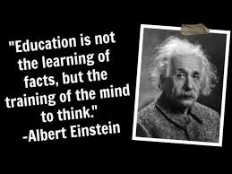

Slide 34
Some factors which inhibits our ability to think clearly and logically
Emotions
Narrow-mindedness
Distrust

Slide 35
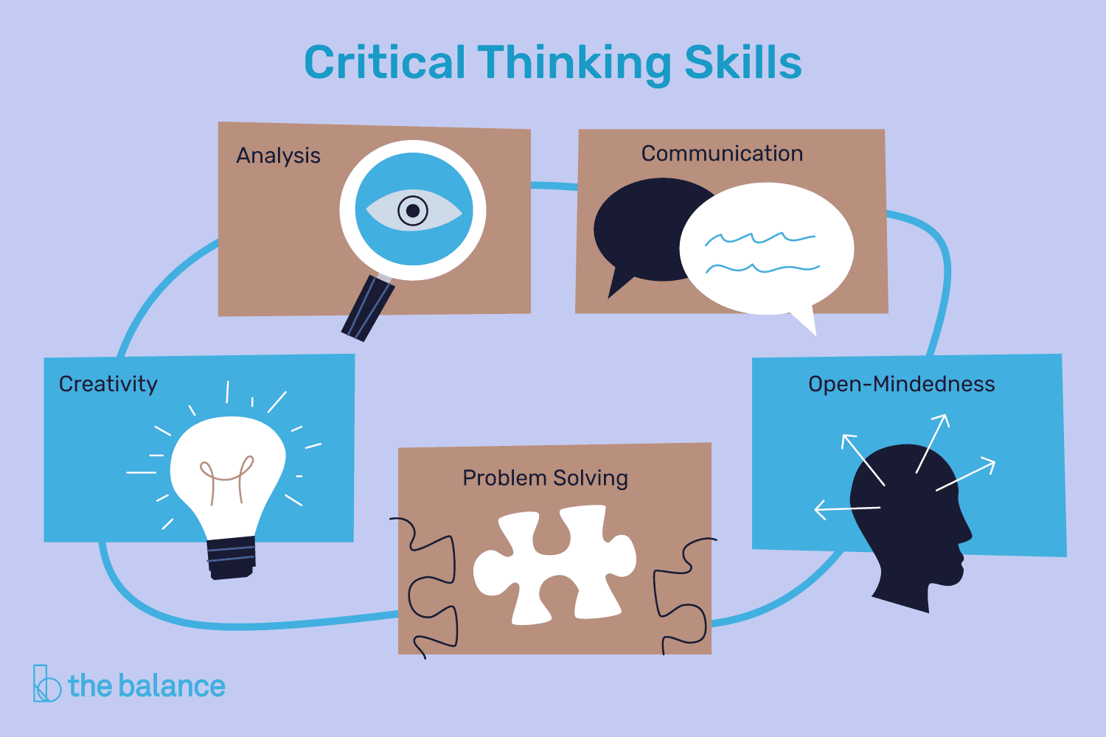

Slide 36
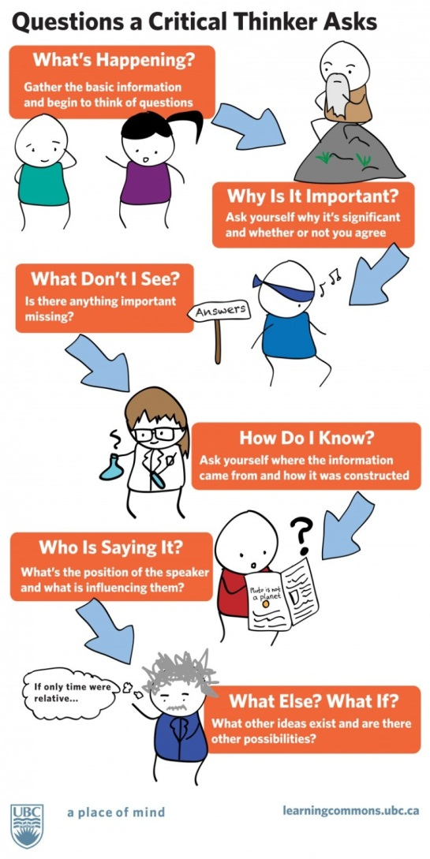

Slide 37
How to Improve Your Critical Thinking Skills?
Know exactly what you want
Deal with your biases
Consider the consequences of your options
Do your research
Accept the fact that you’re not always right
Break it down
Don't overcomplicate things

Slide 38
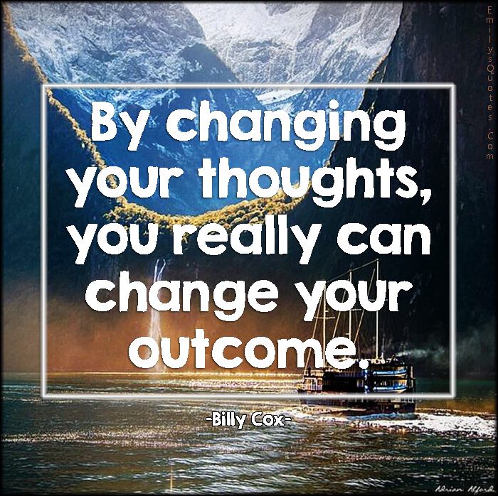

Slide 39
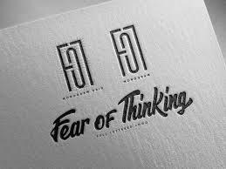

Slide 40
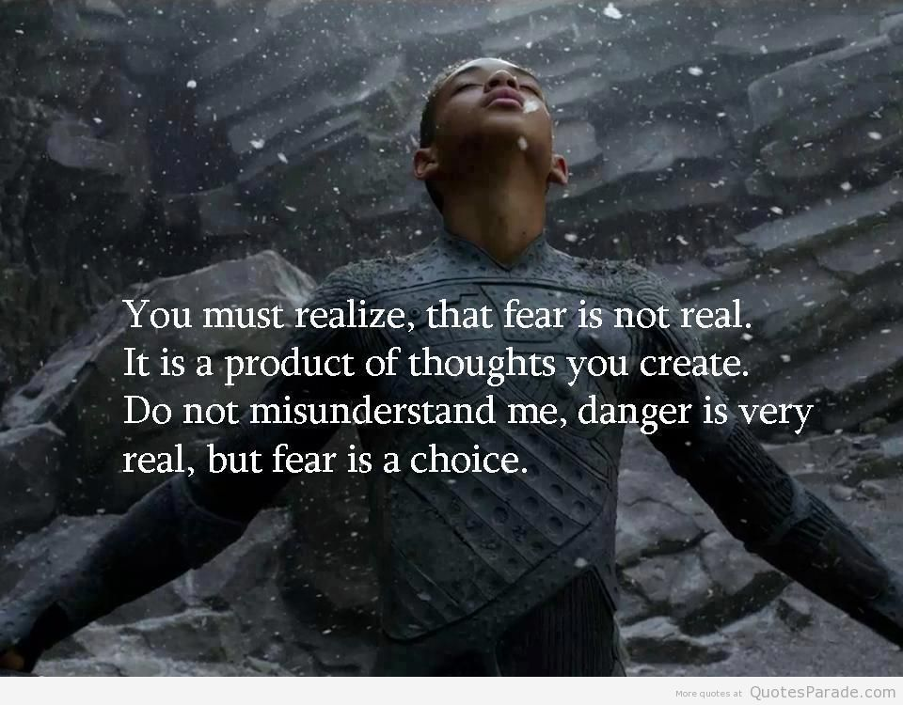
REMEMBER

Slide 41
Activity 1: Think for Yourself
To begin to think about your thinking, make a list of problems you believe currently exist with your thinking. Try to be as explicit as possible. The more problems you identify the better.
Complete the following statements for each of the problem you have identified,
One problem with my thinking is…
This is a problem because…
If I adequately addressed this problem, the quality of my life would improve in the following ways…

Slide 42
Activity 2: Critique Your Thinking
Consider your thinking in these domains of your life: at work, in personal relationships, in teaching, in intimate relationships, as a reader, as a writer, in planning your life, in dealing with your emotions, in figuring out complex situations.
Complete these statements:
Right now, I believe my thinking across all domains of my life is of ______________ quality. I based this judgment on _________________.
In the following areas, I think very well…
In the following areas, my thinking is OK, not great, but not terrible either…
In the following areas, my thinking is probably of low quality…
List at least three areas for each of the above.

Slide 43
Thank you!

